Slide 2
The Business-Higher Education Forum is a national network connecting pioneering corporate and higher education leaders to identify emerging skills and co-develop pathways that address talent gaps.
We empower and catalyze collaborations that deliver accelerated, inclusive, and effective solutions across education and work.
Business and university leaders join the Forum to lead innovation that meets the changing talent needs of learners, workers, and businesses.

Slide 3
Goals and Methods

Slide 4
Guiding Research Questions & Methodology
Research Questions
The Marketplace for Internships. How do the internships that employers offer compare to market demand?
Employer Motivations and Barriers. What factors influence employers’ production of internships?
Strategies to Increase Supply. What resources might be effective at increasing employer engagement and supply?
Methods
Secondary Research
Review of academic and grey literature
Analysis data from existing surveys and labor market info
Scan of state policies and practices
Qualitative Exploration
Interviews with BHEF members/partners (n=8)
Employer focus groups (~n=25)
Employer Survey
Employer Perspectives Survey (EPS) (n=2,700)
Notes:
CW

Slide 5
The Marketplace for Internships

Slide 6
Internships provide… LEARNERS with an enduring advantage
Immediately after completing their internship, former interns tend to have more job offers, higher pay, and a greater likelihood of finding work aligned with their education
In the future, former interns are better able to “signal” those skills to future employers and avoid long-term underemployment
Compared to those without an internship, former interns are more likely to..
Source: BHEF. 2024. Expanding Internships Harnessing Employer Insights to Boost Opportunity and Enhance Learning, Figure 1.

Slide 7
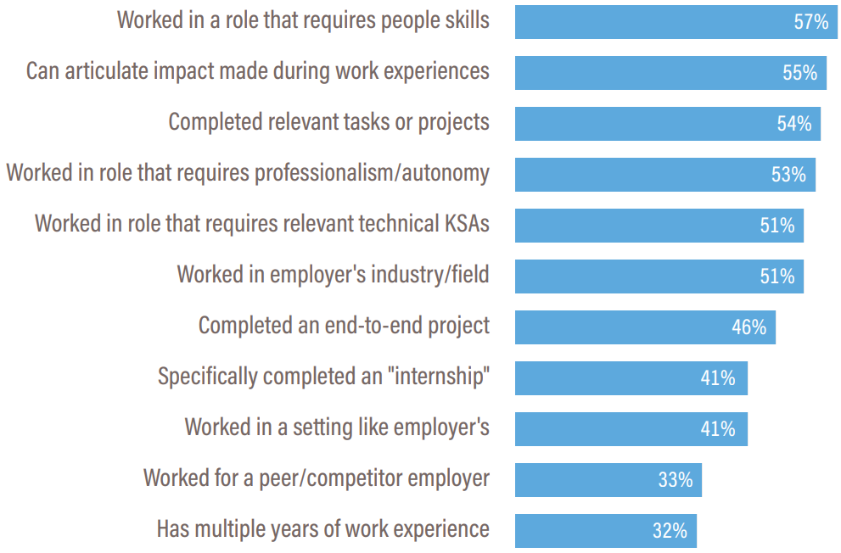
Internships provide… EMPLOYERS with skilled, experienced new workers
Share of employers that feel element of recent
grad’s work history is important when hiring
When considering a recent graduate’s work experience, employers are looking for candidates who possess people skills, have completed relevant on-the-job projects, and can demonstrate their ability to work autonomously in a professional setting.
Source: BHEF. 2024. Expanding Internships Harnessing Employer Insights to Boost Opportunity and Enhance Learning, Figure 3. n=2,089.

Slide 8
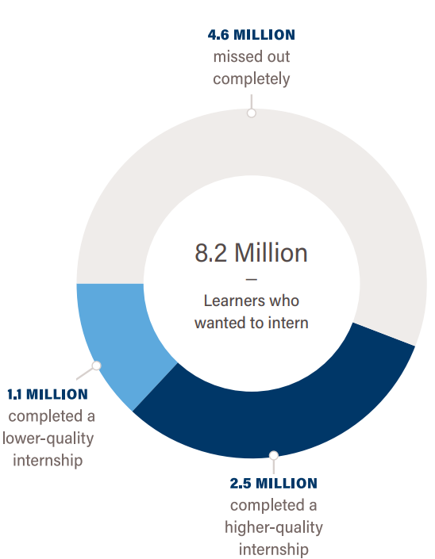
Despite strong demand, most learners who want a quality internship “miss out”
Number of learners who want to intern, by outcome
BHEF estimates that U.S. employers offered 3.6 million internships in 2023, less than one opportunity for every two learners who wanted to intern –
4.6 million learners missed out completely
Source: BHEF. 2024. Expanding Internships Harnessing Employer Insights to Boost Opportunity and Enhance Learning, Figure 2.

Slide 9
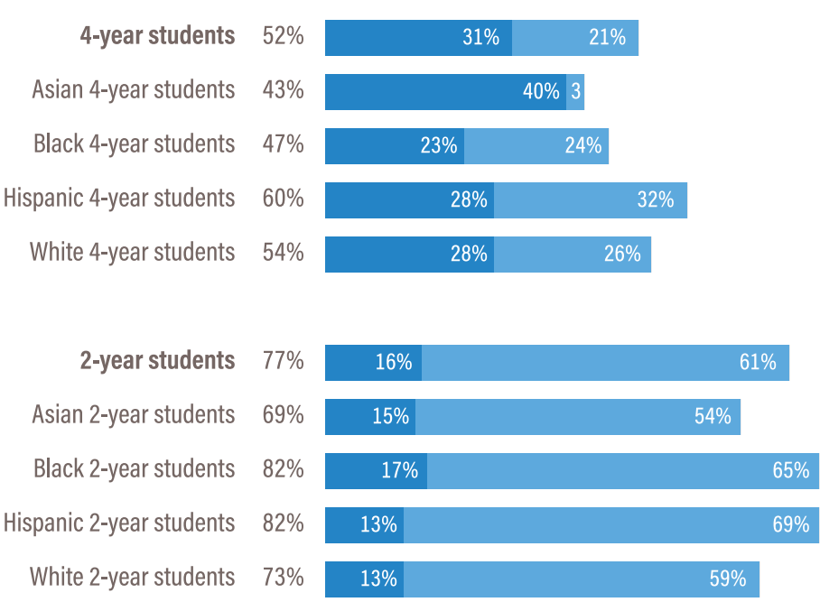
Students of color and those from a two-year program most likely to miss out
Share of students who wanted to intern but “missed out”,
by program type and student race-ethnicity
Hispanic students from two-year and four-year programs and Black students from two-year programs are the most likely to miss out on having an internship and Asian students from four-year programs are most likely to be rejected.
Source: BHEF. 2024. Expanding Internships Harnessing Employer Insights to Boost Opportunity and Enhance Learning, Figure 4.

Slide 10
Employer Factors that Influence
Internship Availability and Quality

Slide 11
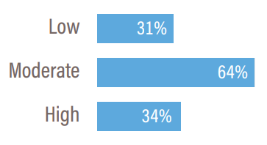
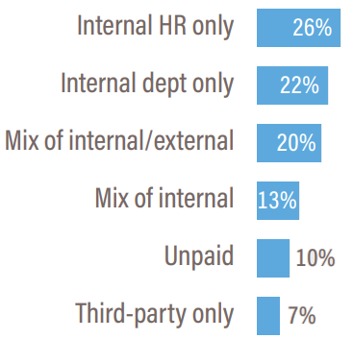
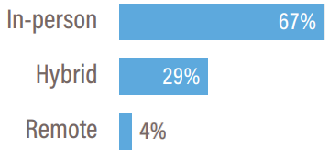
Employers offer range of internship structures, a choice that influences their supply
Employers are exploring alternatives to the “traditional” on-site, summer/semester-based program.
​Intensity
Setting
Funding
Low-intensity (micro) internships often occur as a supplement to more intensive opportunities, while high-intensity (year-long) placements can serve as stand-alone opportunities that provide enough time for engagement, teamwork, and projects.​
Employers often look for new hires with experience in their work setting. Employers were mixed on the utility of offering internships fully-online, with some noting the difficulty of managing and engaging a short-term virtual employee.​
90% of employers pay their interns, with most financing coming from internal sources. About one in four employers (27%) used some amount of external funding to support their internships, with 7% of relying solely on a third-party. ​
Share of employers-with-internships, by duration
Share of employers-with-internships, by location
Share of employers-with-internships, by funding
Source: BHEF. 2024. Expanding Internships Harnessing Employer Insights to Boost Opportunity and Enhance Learning, Figure 13. N=2,036.

Slide 12
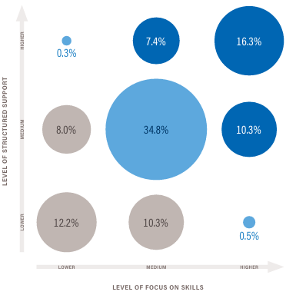
A third of employers with internships offer higher quality experiences
Markers of Structured Support:
Formally onboarded
Placed with a trained supervisor
Receive centralized resources/supports
Placed with a staff “buddy”/mentor
Receive regular feedback
Have satisfaction/engagement tracked
Markers of Focus on Skills Development:
Receive clear learning outcomes
Work on a team
Learn internal tools/systems
Start and complete a project
Present work
Have skills tracked
Higher-level of quality = 5 or more markers
Medium-level of quality = 2-4 markers
Lower-level of quality = 0-1 markers
Source: BHEF. 2024. Expanding Internships Harnessing Employer Insights to Boost Opportunity and Enhance Learning. N=2,036.

Slide 13
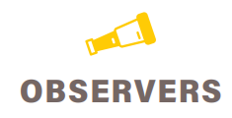
Early-career hiring behaviors can be used to classify employers into four core profiles
BHEF has developed a typology for classifying employers based on their early-career hiring behaviors.
offer internships and full-time jobs for recent grads​
offer internships but do not have full-time jobs for recent grads​
have full-time jobs for recent grads but do not offer internships​
neither offer internships nor full-time jobs for recent grads​
Source: BHEF. 2024. Expanding Internships Harnessing Employer Insights to Boost Opportunity and Enhance Learning, Figure 7.
offer internships and full-time jobs for recent grad | offerinternships but do not have full-time jobs fo recent grads
have full-time jobs for recent grads but do not offer internships | neither offer internships nor full-time jobs for recent grads

Slide 14
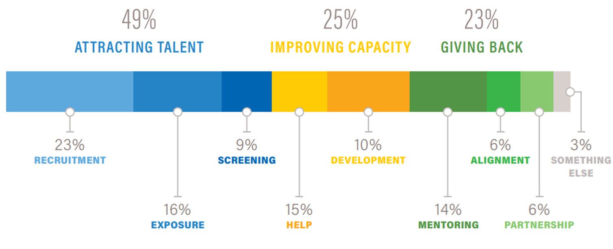
Half of employers motivated to offer internships primarily to attract early-career talent
Share of employers by primary motivation to offer internships
Source: BHEF. 2024. Expanding Internships Harnessing Employer Insights to Boost Opportunity and Enhance Learning, Figure 9. n=2,692.

Slide 15
Poll Question

Slide 16
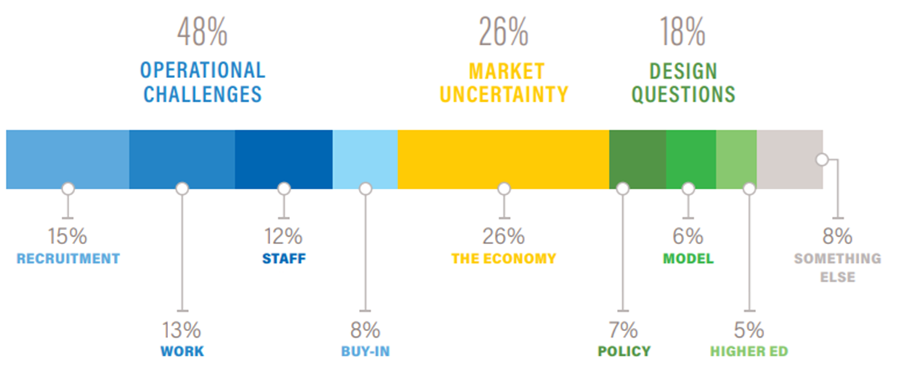
Half of employers constrained primarily by operational challenges
Share of employers by primary barrier to offering internships
Source: BHEF. 2024. Expanding Internships Harnessing Employer Insights to Boost Opportunity and Enhance Learning, Figure 10. N=2,692.

Slide 17
Poll Question

Slide 18
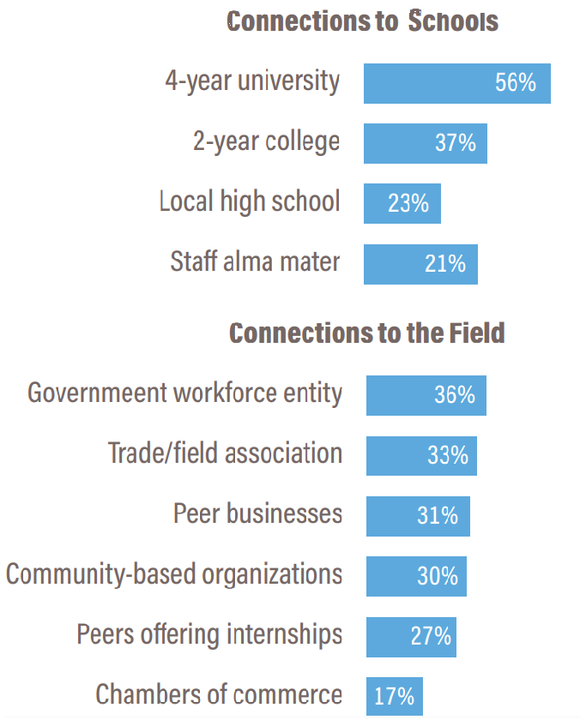
A variety of partnerships and resources can be leveraged to increase internship supply
Share of employers that feel partner would help begin/expand internships
Employers are interested in receiving that support through partnerships with higher education, including four-year universities and two-year institutions.
Connections with entities in the field are perceived as less important, particularly chambers of commerce.
Source: BHEF. 2024. Expanding Internships Harnessing Employer Insights to Boost Opportunity and Enhance Learning, Figure 16. N=2,036.

Slide 19
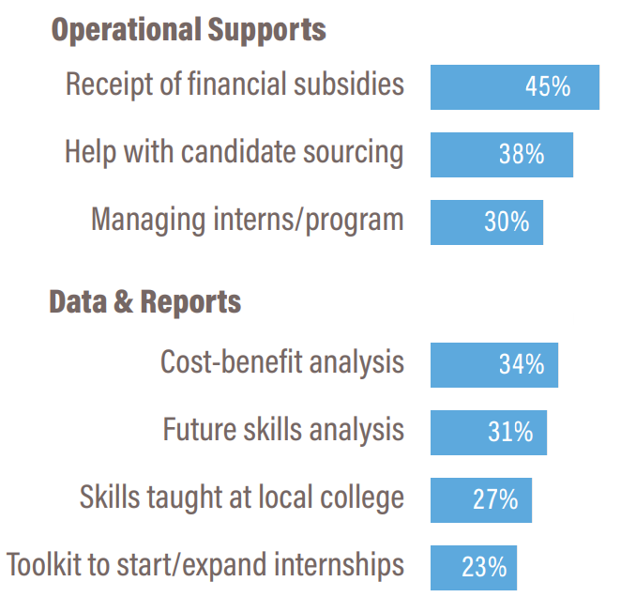
A variety of partnerships and resources can be leveraged to increase internship supply
Share of employers that feel resource would help begin/expand internships
Employers are interested in support to (a) cover internship program costs, (b) find and recruit candidates, and (c) conduct a cost-benefit analysis would bolster their ability to offer internships.
They are not especially interested in receiving a toolkit to help them start or expand internships.
Source: BHEF. 2024. Expanding Internships Harnessing Employer Insights to Boost Opportunity and Enhance Learning, Figure 16. N=2,036.

Slide 20
Key Recommendations
Insights into the distinct needs of employers based on their early-career hiring behaviors can be used to tailor interventions and help increase the number of internships offered.
Intermediary structures are an important tool for building capacity within smaller, less-resourced institutions and companies, as well as for ensuring interns have access to wraparound supports and consistently high-quality opportunities.
We need to strengthen the experiential learning ecosystems by designing and testing low-intensity and high-intensity programs that intentionally focus on shared employer and learner goals.
Understanding what elements must be in place for an opportunity to be considered a quality internship will yield better estimates of participation and make sure students, colleges, businesses, and intermediaries speak the same language.

Slide 21
Thank You!
Contact us at:
Kristen Fox, CEO, Kristen.Fox@bhef.com
Jennifer Thornton, SVP & Chief Programs Officer, Jennifer.Thornton@bhef.com
Candace Williams, Director of Regional Initiatives, Candace.Williams@bhef.com

